Slide 1

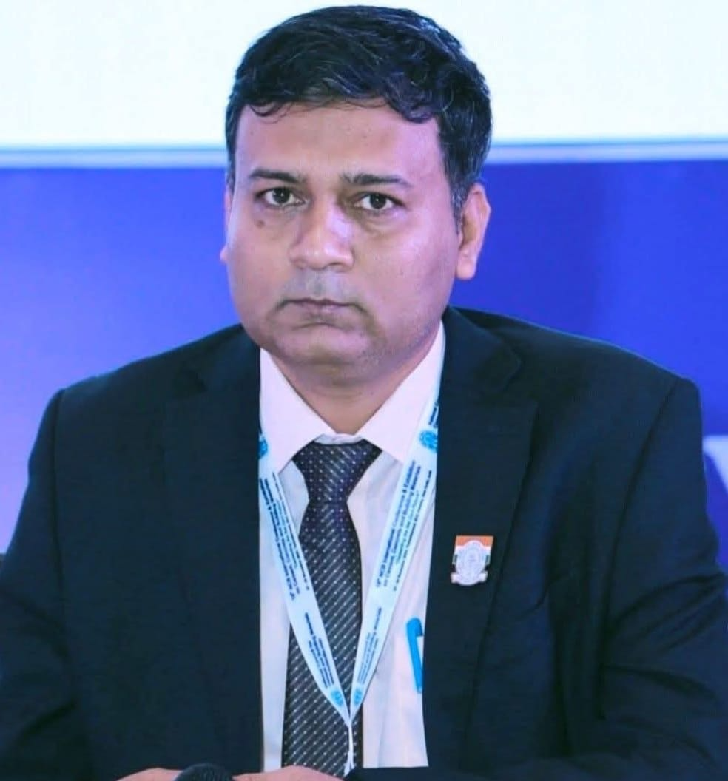
Webinar Series No. 67
READY MIXED CONCRETE
MANUFACTURERS’ ASSOCIATION
has organised
Webinar
on
Quality Control and Quality Assurance of Concrete Constructions – Provisions as per IS 456:2025 (Draft)
Date: Thursday 22nd October 2026 Time: 3.00 pm to 05.00 pm
Link: https://zoom.us/j/91981816663?pwd=WBrb8JHeeES2KB1bUzo1pPAfsVZdbJ.1
Meeting ID: 919 8181 6663 Passcode: 279404
The Topic:
The webinar focuses on Quality Control (QC) and Quality Assurance (QA) of concrete construction in accordance with IS 456:2025 (Draft). It highlights the systematic approach required to achieve consistent concrete quality, structural safety, durability and long-term performance. The program addresses material control, mix quality, workmanship, testing, inspection, site supervision, acceptance criteria and documentation throughout construction. Particular emphasis is placed on implementing code-based quality systems from material selection and batching to placement, compaction, curing and assessment. The session aims to bridge the gap between design provisions and practical site execution, supporting reliable, durable and sustainable concrete structures on construction sites effectively.
The Faculty:
Dr. Brijesh Singh is a distinguished civil engineering professional, researcher, technologist and standards expert with about two decades of experience in concrete technology, structural condition assessment, quality assurance, research and development, and sustainable construction materials.
He holds a B.E. in Civil Engineering as a Gold Medalist, an M Tech. in Structural Dynamics from IIT Roorkee, and a Ph.D. in Concrete Technology from BITS Pilani. He serves as General Manager and Program Leader–Concrete Technology at the Centre for Construction Development and Research (CDR), and Head, Centre for Continuing Education Services (CCE) at National Council for Cement and Building Materials, Haryana. His expertise spans durability, high-strength and ultra-high-performance concrete, advanced composites, supplementary cementitious materials, industrial waste utilisation and sustainable construction. He has published 170+ research papers and 10 book chapters.
He is associated with 15 BIS committees and expert panels, including revision of IS 456, and contributes to national and international standardisation and code development for concrete construction practices. For his significant work in field of concrete and construction sector he has been conferred with many awards such as outstanding concrete technologist, national young scientist, CIDC Vishwakarma award, Award for Excellence in R&D, Rising Star and many more.
Dr. Brijesh Singh
Ready Mixed Concrete Manufacturers’ Association
Mob. No.: +91 93241 11122, Email: info@rmcmaindia.org
Website: www.rmcmaindia.org

